Slide 1


Prediction for Credit Card Approval
-Prerak Pandya

Slide 2

Problem Statement:
The primary objective of this project is to predict the approval or rejection of credit card applications.
The challenge lies in understanding the key factors influencing credit card approval decisions and
building a predictive model to assist in the decision-making process.

Slide 3
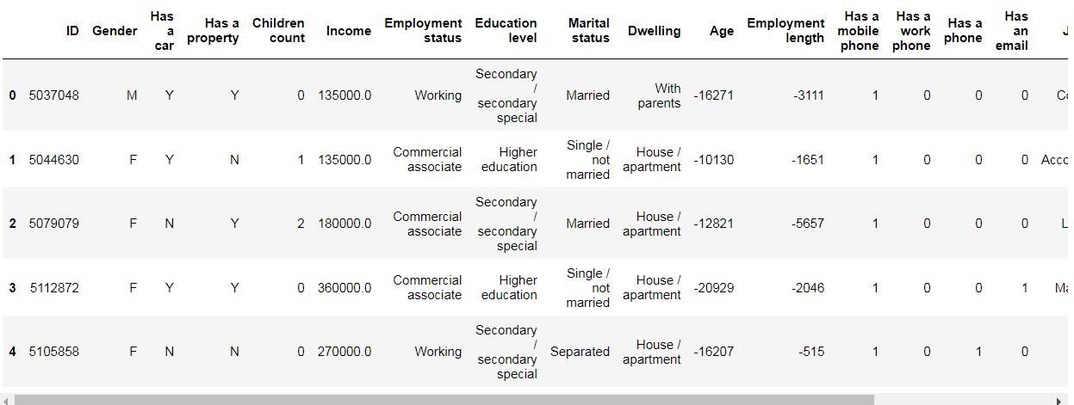
Dataset Overview:
➢ ID: Unique identifier for each record.
➢ Gender: Gender of the applicant.
➢ Has a car: Indicates whether the applicant owns a car (binary: 0 or 1).
➢ Has a property: Indicates whether the applicant owns a property (binary: 0 or 1).
➢ Children count the number of children the applicant has.
➢ Income: Income of the applicant.
➢ Employment status: Employment status of the applicant.
➢ Education level: Highest education level attained by the applicant.
➢ Marital status: Marital status of the applicant.
➢ Dwelling: The type of dwelling the applicant resides in.
➢ Age: Age of the applicant.
➢ Employment length: Duration of the applicant's current employment.
➢ Has a Mobile phone: Indicates whether the applicant has a mobile phone (binary: 0 or 1).
➢ Has a work phone: Indicates whether the applicant has a work phone (binary: 0 or 1).
➢ Has a phone: Indicates whether the applicant has any phone (binary: 0 or 1).
➢ Has an email: Indicates whether the applicant has an email (binary: 0 or 1).
➢ Job title: Title or position of the applicant's job.
➢ Family member count: Number of family members.
➢ Account age: Age of the applicant's account.
➢ Is high risk (Target Variable) : Whether the applicant is considered high risk (0 for no, 1 for yes).

Slide 4





Steps to solve Problem
- Import data set
- Understand the data
- Import the important libraries
- Go through EDA process
- Visualization
- Appley suitable ML algorithmS
- Model Evaluation

Slide 5

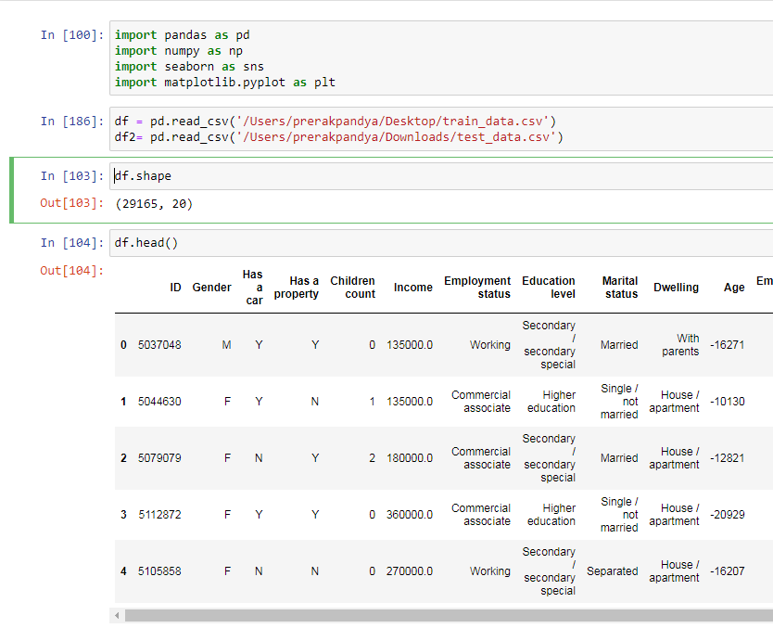



First Import Library like Pandas, NumPy Pandas : for import file and cleaning process NumPy : for statistics purpose seaborn and matplotlib : for visualization

Slide 6
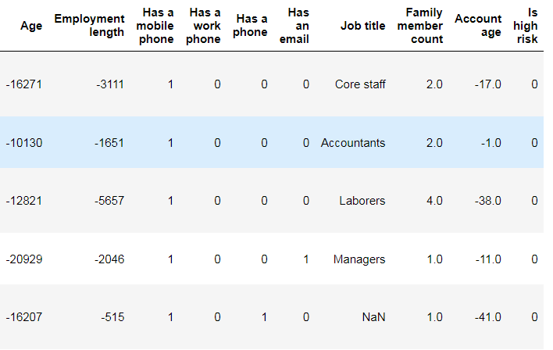
Drop Columns/Duplicate data There are 29165 rows and 20 columns in the data. As there are some negative values in the data, we need to drop the columns containing them, which can be done using the drop function. We don’t find any duplicate data

Slide 7
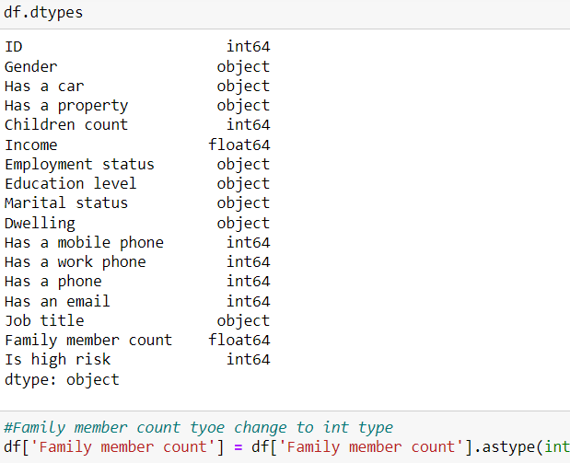
Changing datatype We used the dtype () function to convert the 'family member' column from float64 to int after checking the data type of each column.

Slide 8
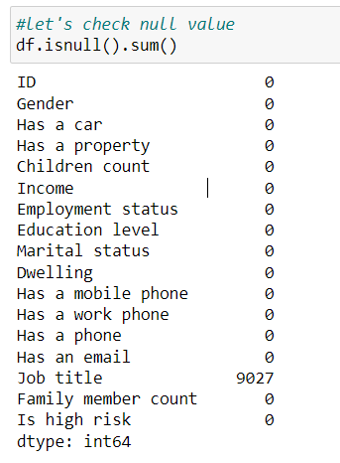
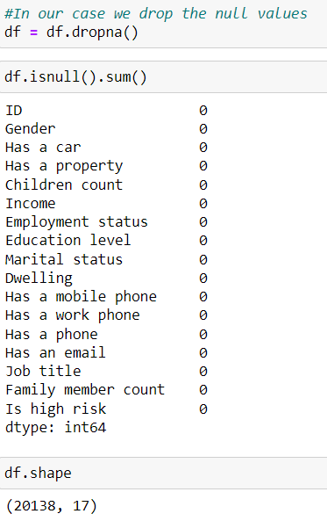
Facing Null Values
Here, we have some null values in our data.
To deal with these null values, we have multiple options available. The first option is to drop the null values altogether.
The second option is to replace the null values with the median value or integer value (if the data type is int).
These two options are the most commonly used methods for dealing with null values. Another option is to use forward or backward fill, which is mostly used in forecasting data
Additionally, we can use interpolation to estimate the value based on other data.

Slide 9
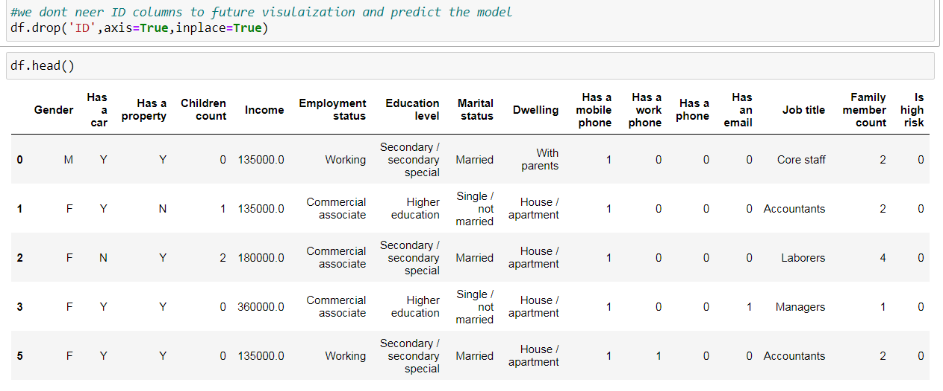
Remove ID columns
By removing ID columns, we can enhance the accuracy of future visualization and model predictions. Therefore, it is recommended to exclude ID columns from the dataset.

Slide 10
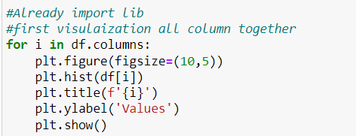
Visualization
To visualize data, import Seaborn and Matplotlib and use a loop function to display all int dtypes on a histogram chart, providing insight.

Slide 11
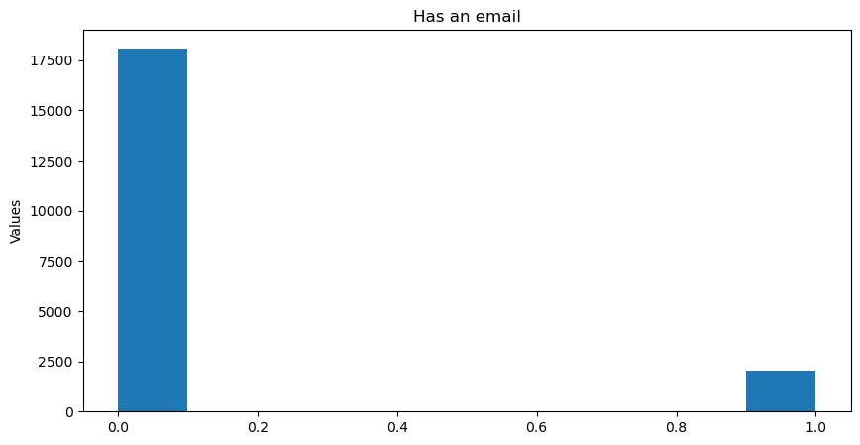
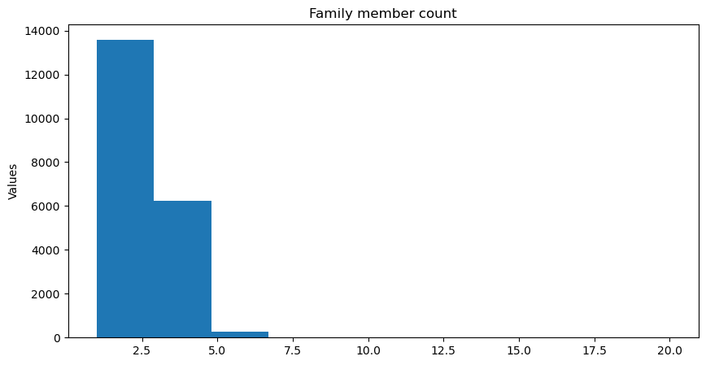
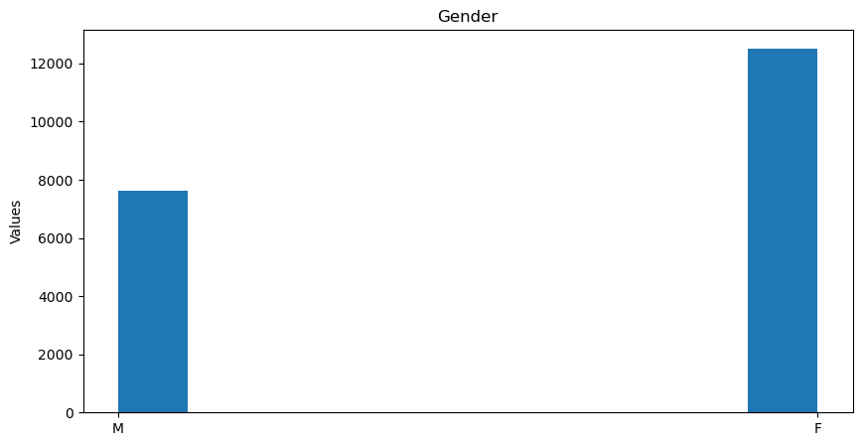
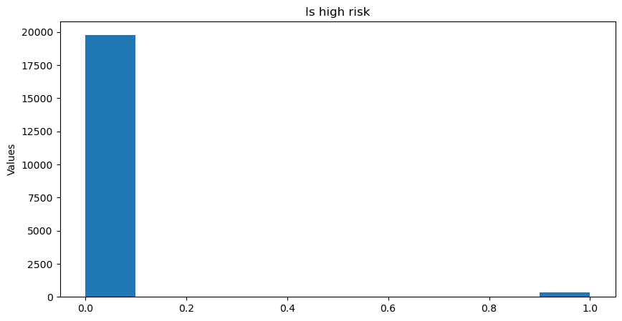
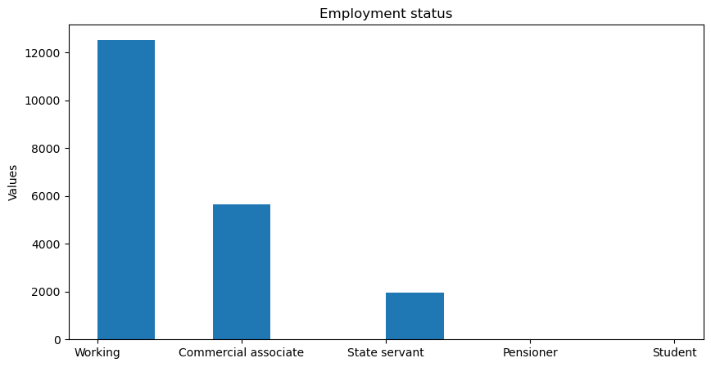
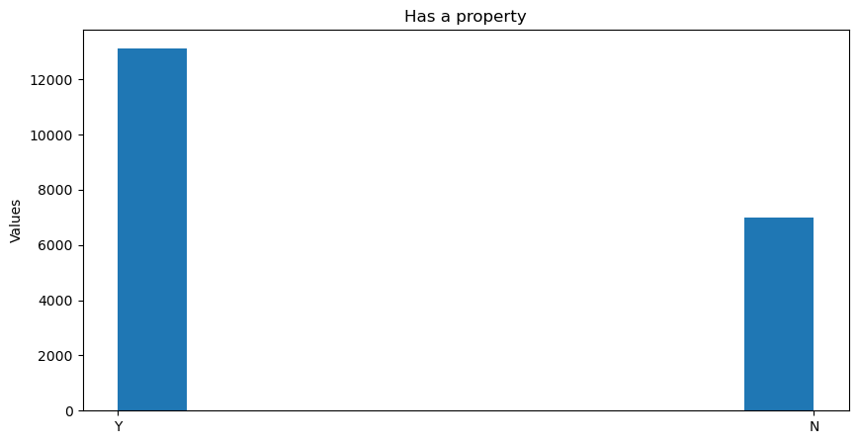
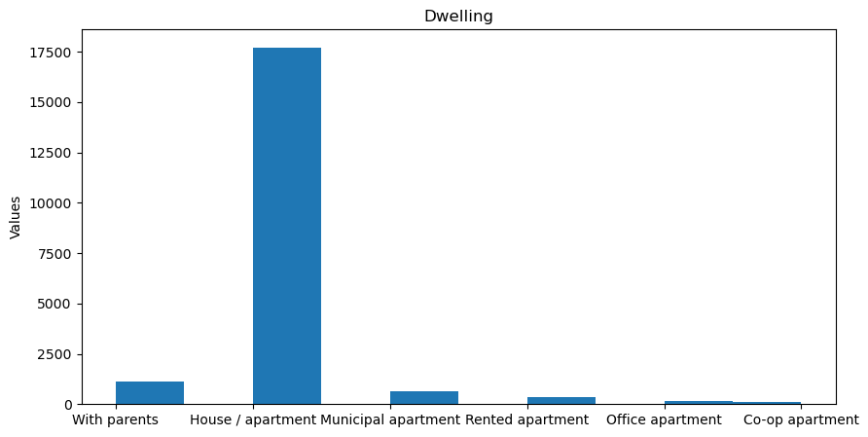
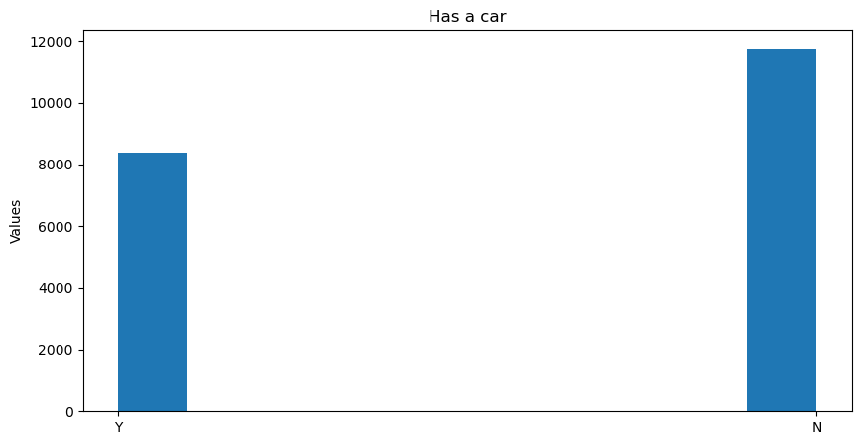
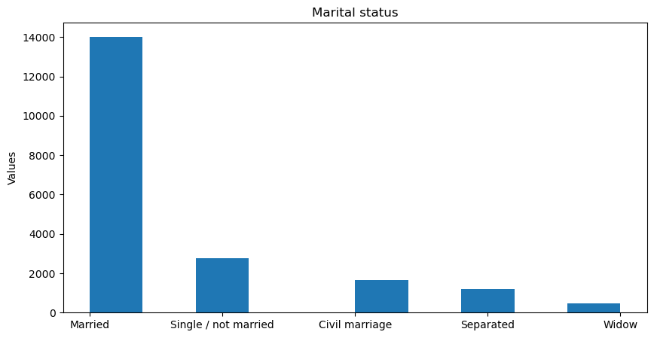
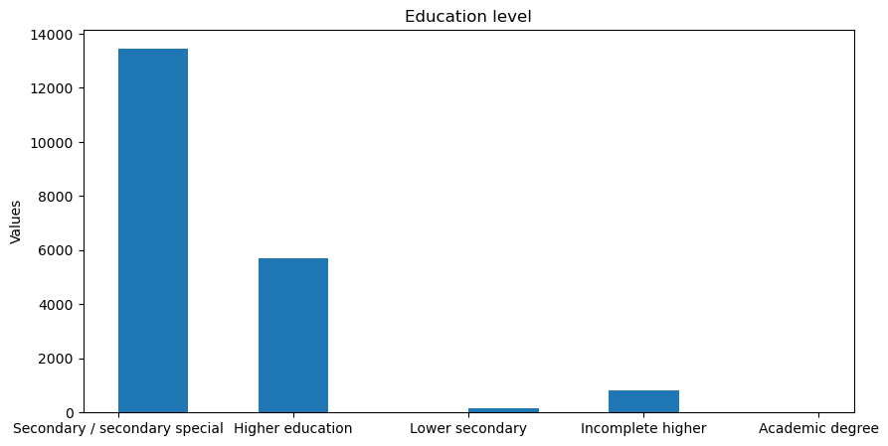

Slide 12
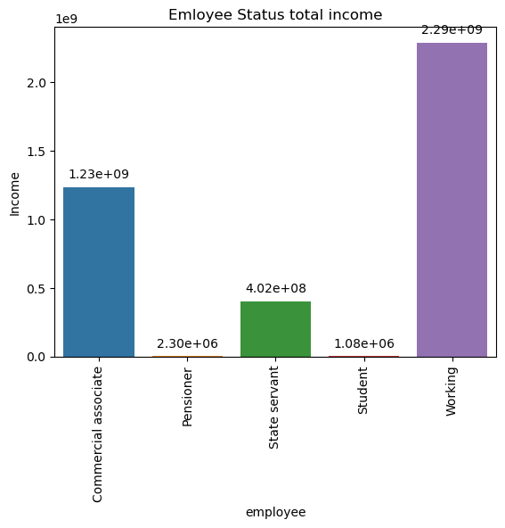
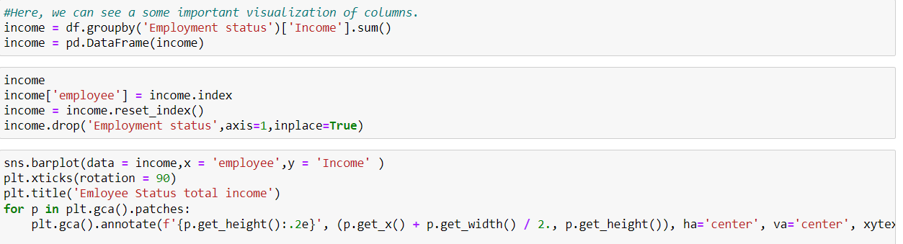
Visulaization
Most employee income comes from working, commercial associates followed by state servants etc

Slide 13
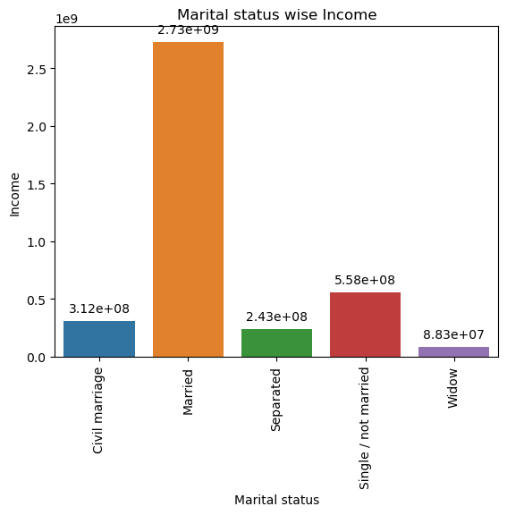
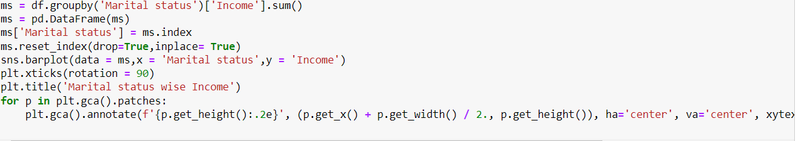
Visualization Marital status-wise income
Married couples have the highest income, followed by singles, those in civil marriages, separated individuals, and widows.

Slide 14
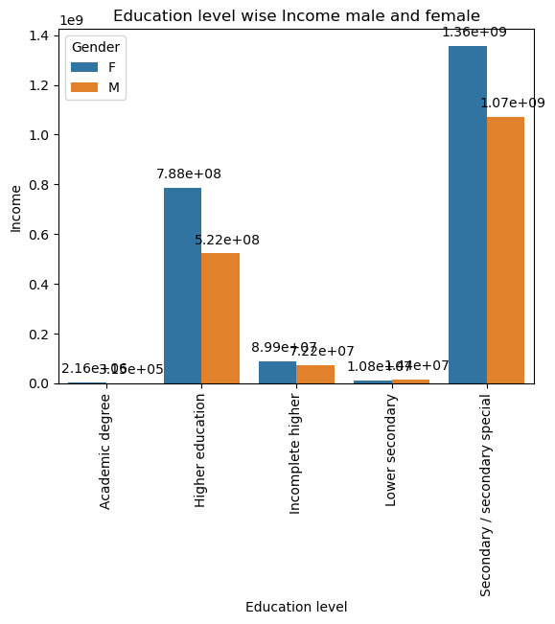
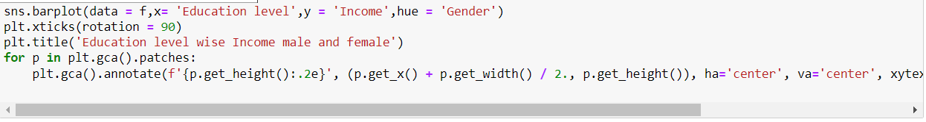
Visualization Education level wise income male and female
It appears that in secondary education, there is more funding and a higher percentage of females than males.
This trend continues into higher education, where females also dominate
Women tend to have more prominent facial features than men

Slide 15
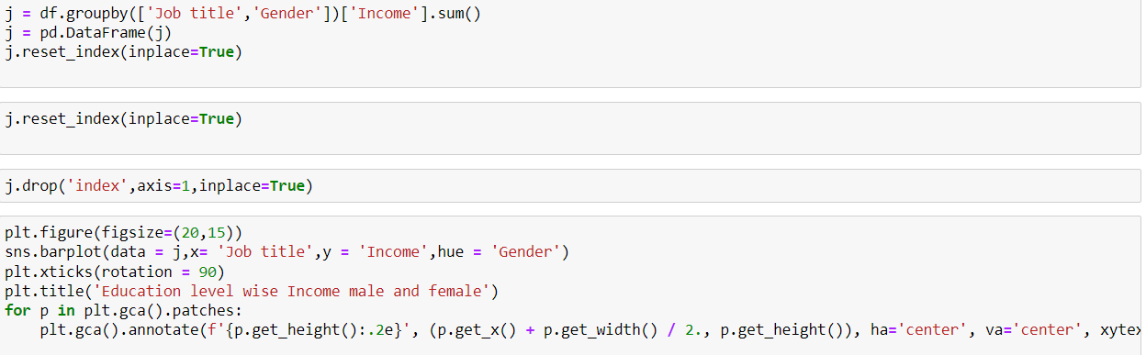
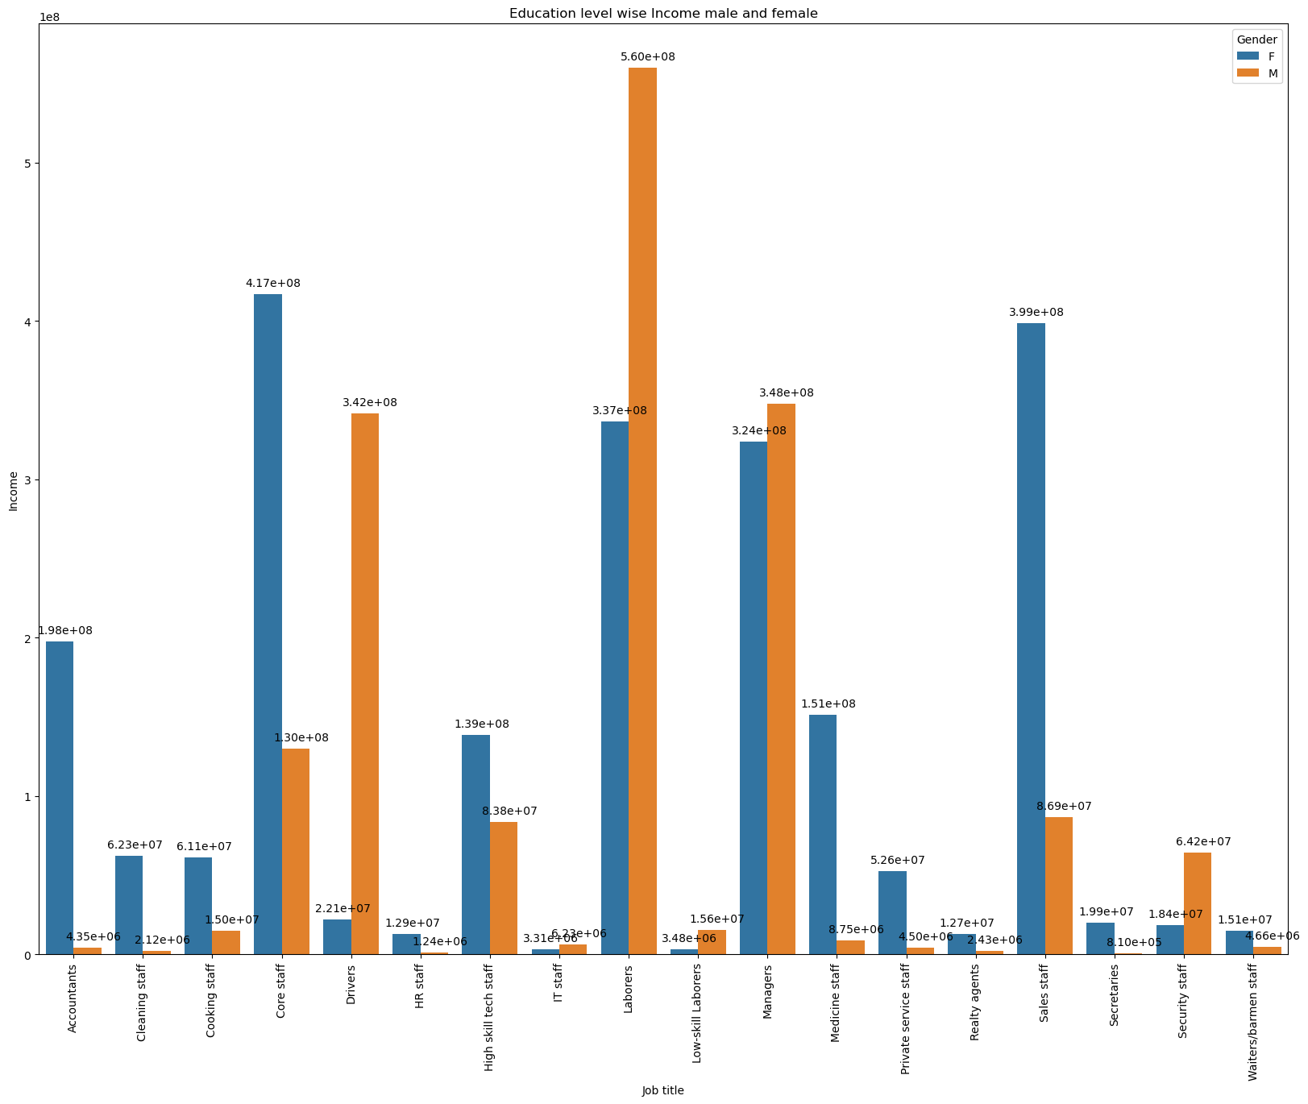
Visualization Job title vs income
Based on the job titles, it appears that males have higher education levels and incomes compared to females.
Most males earn their income from labour jobs, while most females earn their income from core staff jobs.
On the other hand, fewer males earn their income from IT jobs, while fewer females earn their income from HR jobs.

Slide 16
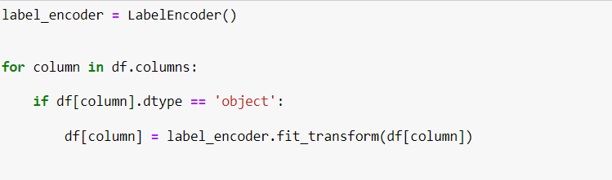
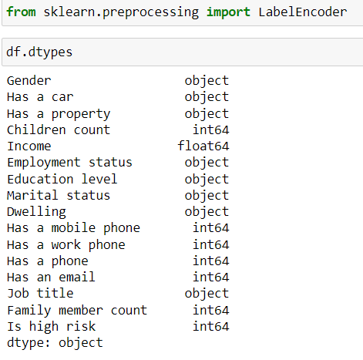
Encoding Process
We will predict credit card approval. To do this, we will encode the data since we are dealing with a classification problem.
Import LabelEncoder
We use a loop function where the data type is object inserts label encoding

Slide 17
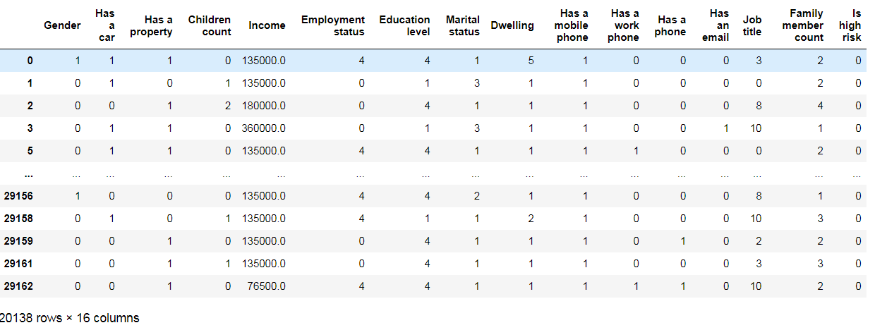

Slide 18
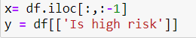
Built Models
Split the data into independent and target variables. Import library to help predict the model. In our case, the target variable is 'high risk’.
X = independent variable using ilock function
Y = is Target variable

Slide 19
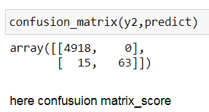
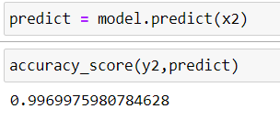
Logical Regression
Confusion Matrix
Import the logical regression library.
Build a model using train data with x as independent and y as the target variable.
Then, import the test data set similar to the train data set and predict the model.
"We were able to achieve 99% accuracy using the model evaluation tool accuracy score."
"The variable x2 is independent of the test data.data."

Slide 20
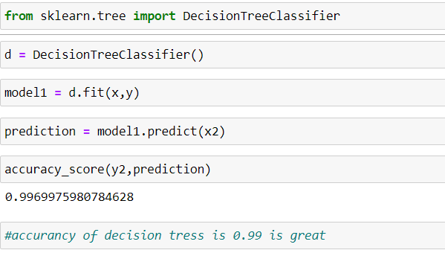
Decision Tree
Decision trees are a fundamental machine learning algorithm used for both classification and regression tasks. They are a type of supervised learning algorithm that works by recursively partitioning the data into subsets based on the value of input features.
Import the decision tree classifier library.
Build a model using train data with x as independent and y as the target variable.
Then, import the test data set similar to the train data set and predict the model.
"We were able to achieve 99% accuracy using the model evaluation tool accuracy score."
Training Dataset
Test Dataset

Slide 21
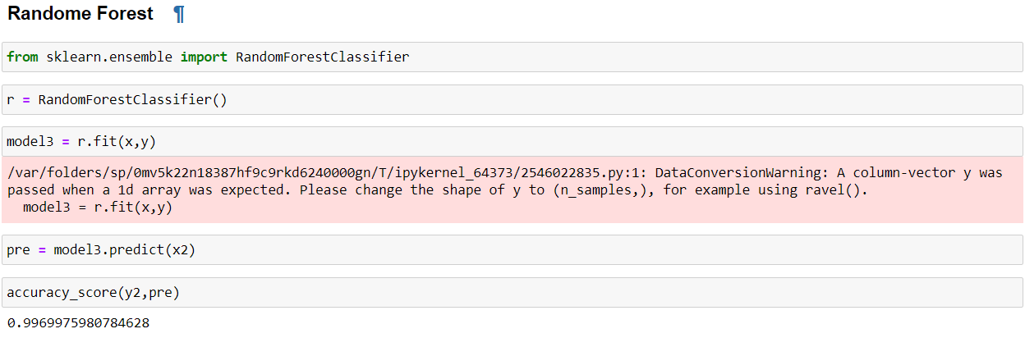
Random Forest
Random forest is a popular machine-learning algorithm used for both classification and regression tasks
It's an ensemble learning method, meaning it builds multiple decision trees
Import randomforestclassifire library.
Build a model using train data with x as independent and y as the target variable.
Then, import the test data set similar to the train data set and predict the model.
"We were able to achieve 99% accuracy using the model evaluation tool accuracy score."

Slide 22
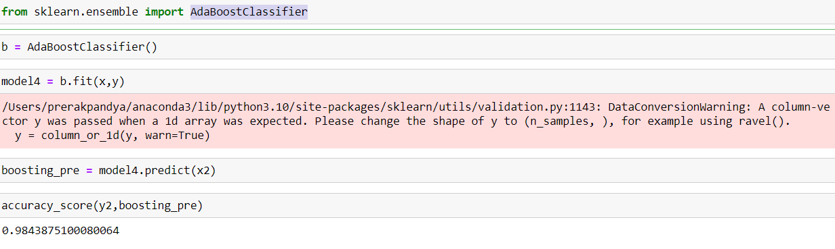
AdaBoostClassifier
Adaboostclassifier is a popular ensemble learning algorithm used for classification tasks. It stands for adaptive boosting and works by combining multiple weak learners (typically decision trees) to create a strong classifier.
Build a model using train data with x as independent and y as the target variable.
Then, import the test data set similar to the train data set and predict the model.
"We were able to achieve 98% accuracy using the model evaluation tool accuracy score."
Train Dataset
Test Dataset

Slide 23

Conclusion
Our models achieve almost 99% accuracy in logical regression, decision trees, and random forests. This means that our models are trained with 99% accuracy.
-Prerak Pandya

